Slide 1

Gene annotation comparisons of the Drosophila genus
Authors: Cheukting Law, Changmin Yu and Yusef Paolo Rabiah

Slide 2
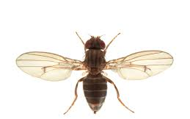
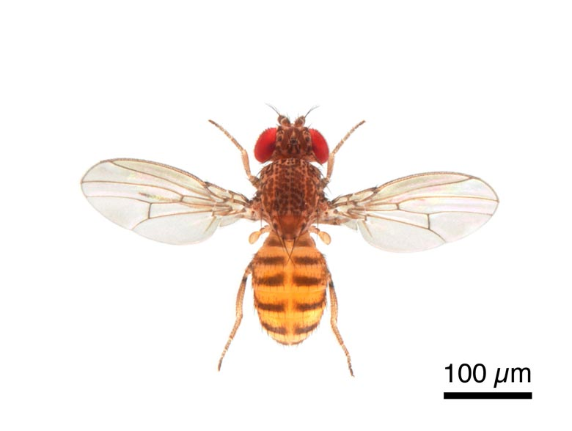
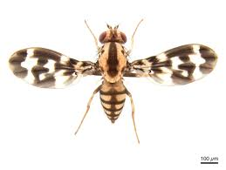
Drosophila species
Species studied:
D. grimshawi, D. virilis and D. mojavensis
Source: Flybase.org
Notes:
Drosophila grimshawi is a species of fruit fly from Hawaii
Drosophila virilis is a species of fruit fly with a worldwide distribution (probably due to human movements),
Drosophila mojavensis is a cactophilic species of fruit fly from the southwestern United States and Mexico,
All three species were part of a large genome comparative study of 12 fruit flies. (Drosophila 12 Genomes Consortium)

Slide 3

Genscan
Uses a probabilistic model to scan for core gene structural features within eukaryotic genomic sequences
These include: promoters, exons, introns, donor and acceptor splice sites
The model places emphasis on the gene features which are recognised by transcriptional, translational and splicing machinery.
Notes:
Doesn’t focus on specialised signals which are only present in particular genes. Won’t search for gene-specific transcription factor binding sites such as SP1 or E2F.
Focuses on generic core features including the TATA box, cap site and polyadenylation (AAUAAA) signals.
Drosophila core promoter database, 43% of core promoters contain a TATA box.
Advantages over Genie:
First, we use an explicitly double-stranded genomic sequence model in which potential genes occuring on both DNA strands are analyzed in simultaneous and integrated fashion. Second, while most existing integrated gene finding programs assume that in each input sequence there is exactly one complete gene, our model treats the general genscan model se in which the sequence may contain a partial gene, a complete gene, multiple complete (or partial) genes, or no gene at al
Restrictions of gene scan:
Only protein coding genes are considered (no tRNA or rRNA genes included)
Transcription units are considered to be non-overlapping

Slide 4
Genscan analysis
The Drosophila genome FASTA files were split into 800,000 bp scaffolds upon insertion into Genscan
Promoter was removed from the Genscan output file to effectively compare to the BLASTn output files.
Low-probability Genscan exons (P < 0.50) are not reliable and have been ignored.
This resulted in the removal of several single exon genes

Slide 5
Problems with Genscan in literature
Intronless genes
Over prediction of genes

Slide 6
Genscan – Gene number
Key Conclusion:
Genscan overpredicts gene number in all studied Drosophila species
Reasons:
- Predicts non-existent genes
- Splits long genes into multiple smaller genes

Slide 7
Genscan – Gene length
Key Conclusion:
Gene lengths predicted by Genscan are slightly shorter than the official gene lengths for all studied Drosophila species.
Reasons:

Slide 8
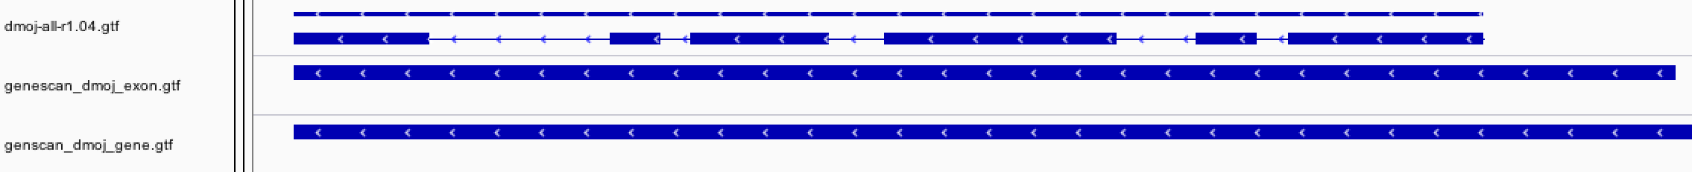
Genscan - Exon number
Key Conclusion:
Exon numbers predicted by Genscan are smaller for all Drosophila species studied.
Reasons:

Slide 9
Genscan - exon length
Predicted length of exons in Genscan correlate positively with the length of the official genes.

Slide 10
Gene annotation in literature Cross species comparison
Drosophila species | Genscan gene predictions | Coding Genes
D. grimshawi | 21,776 | 14,982
D. virilis | 22,393 | 14,491
D. mojavensis | 22,750 | 14,594
D. melanogaster | 18,548 | 13,918
Source: Metazoa Ensembl

Slide 11
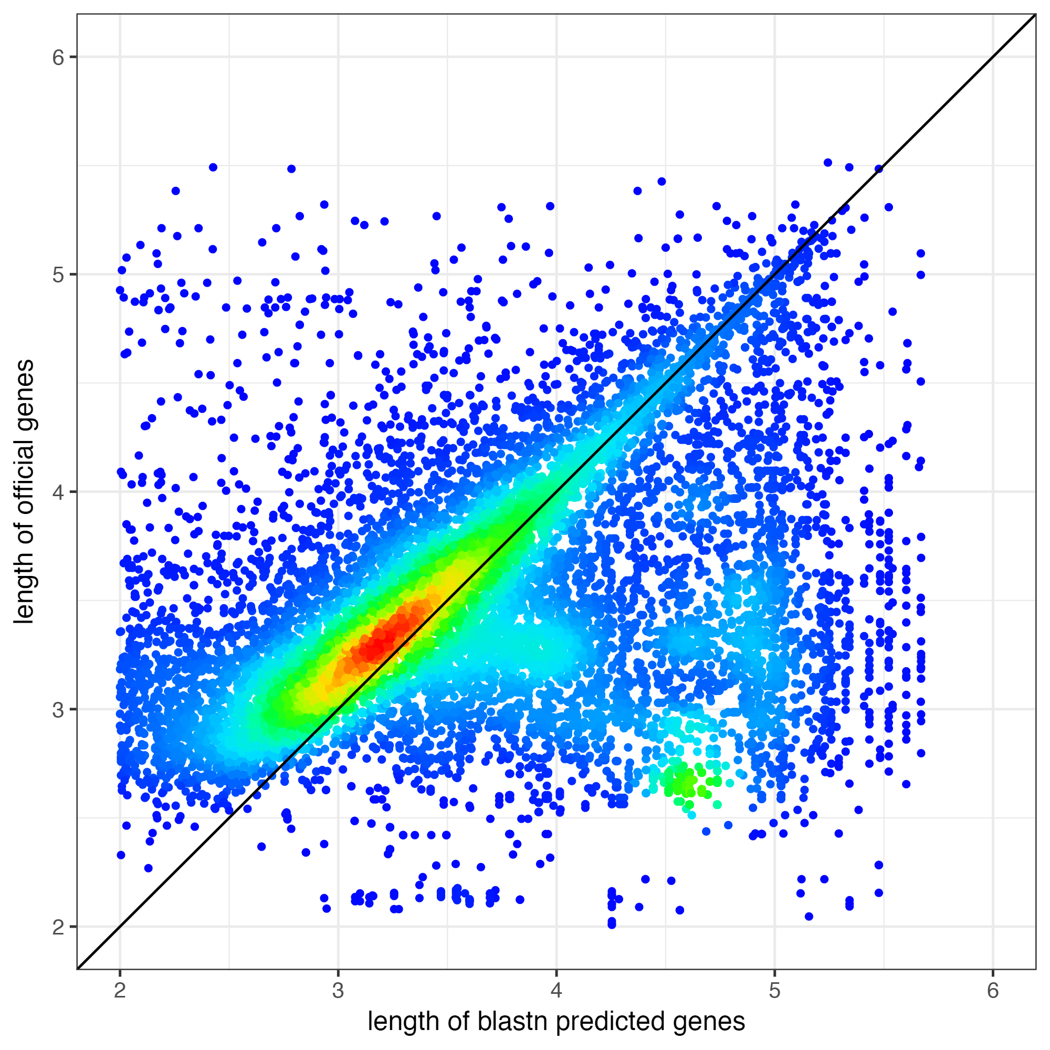
Blastn gene comparison
Gene lengths predicted using Blastn are shorter than the official gene lengths for all Drosophila species.

Slide 12
BLASTn and tBLASTn
tblastn: TBLASTN is a mode of operation for BLAST that aligns protein sequences to a nucleotide database translated in all six frames.
Allows comparison of proteins to an organisms’ chromosomes
Query: D. melanogaster
Target: 3 species’ genome
Notes:
Doesn’t focus on specialised signals which are only present in particular genes.
Focuses on generic core features including the TATA box, cap site and polyadenylation (AAUAAA) signals.
Drosophila core promoter database, 43% of core promoters contain a TATA box.
Advantages over Genie:
First, we use an explicitly double-stranded genomic sequence model in which potential genes occuring on both DNA strands are analyzed in simultaneous and integrated fashion. Second, while most existing integrated gene finding programs assume that in each input sequence there is exactly one complete gene, our model treats the general case in which the sequence may contain a partial gene, a complete gene, multiple complete (or partial) genes, or no gene at al
Restrictions of gene scan:
Only protein coding genes are considered (no tRNA or rRNA genes included)
Transcription units are considered to be non-overlapping

Slide 13
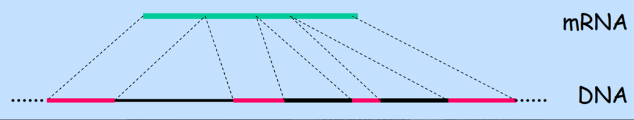
Blastn and the spliced alignment problem
Idea is to align the mRNA sequence (transcript files) to the genomic DNA sequence of the 3 Drosophila species and skip over introns

Slide 14
Blastn analysis
Exon 1
Exon 2
Exon 3
Exon 4
Exon 5
Gene 1.1

Slide 15
Blastn analysis

Slide 16
Classing a gene in Blastn data
Gene 1.1
Gene 1.2
Gene 1.3
Gene 1.1

Slide 17
Notes
“Official genes” source (Fly Base- all transcript file).
Note that on slide exon prediction by genscan
Only exon and not the UTR
Discussion: Combine promoter to blastn output
Combine UTR and 3’UTR

Slide 18
Further work
tRNA and rRNA gene prediction.
Using over ab intio gene prediction tools including GeneMark.

Slide 19
Conclusions
Both Genscan and Blastn have their advantages and disadvantages
Intronless genes not predicted effectively
An alternative method is to combine both methodologies (Twinscan)
Notes:
Genscan was trained on human and vertebrate training sets and so maybe is not as effective at ab initio prediction in invertebrate species.
Blastn used annotation by homology based alignment to look for similar matching sequences.
Genscan overpredicts genes
Genscan also splits long genes into small genes
Twinscan combines the information from predicted coding regions and splice sites with conserservation measurements between the target sequence and sequences from a closely related genome
Extends Genscan by allowing it to exploit to homology between two related genomes.
Twinscan combines the information from predicted coding regions and splice sites with conserservation measurements between the target sequence and sequences from a closely related genome
Twinscan demonstrates additional improved specificity and sensitivity in exon prediction, which can be accredited to modelling evolutionary conservation within genomic sequences.
Twinscan restriction is that it requires an informant genomic sequence of a closely related species to the target genome.

Slide 20
References and code files
1) Drosophila 12 Genomes Consortium. (2007). Evolution of genes and genomes on the Drosophila phylogeny. Nature 450, 203-218
2) Korf I, Flicek P, Duan D, Brent M. (2001).Integrating genomic homology into gene structure prediction. Bioinformatics 17 , 140-148.
(INSERT GITHUB ADDRESS)

